Slide 1
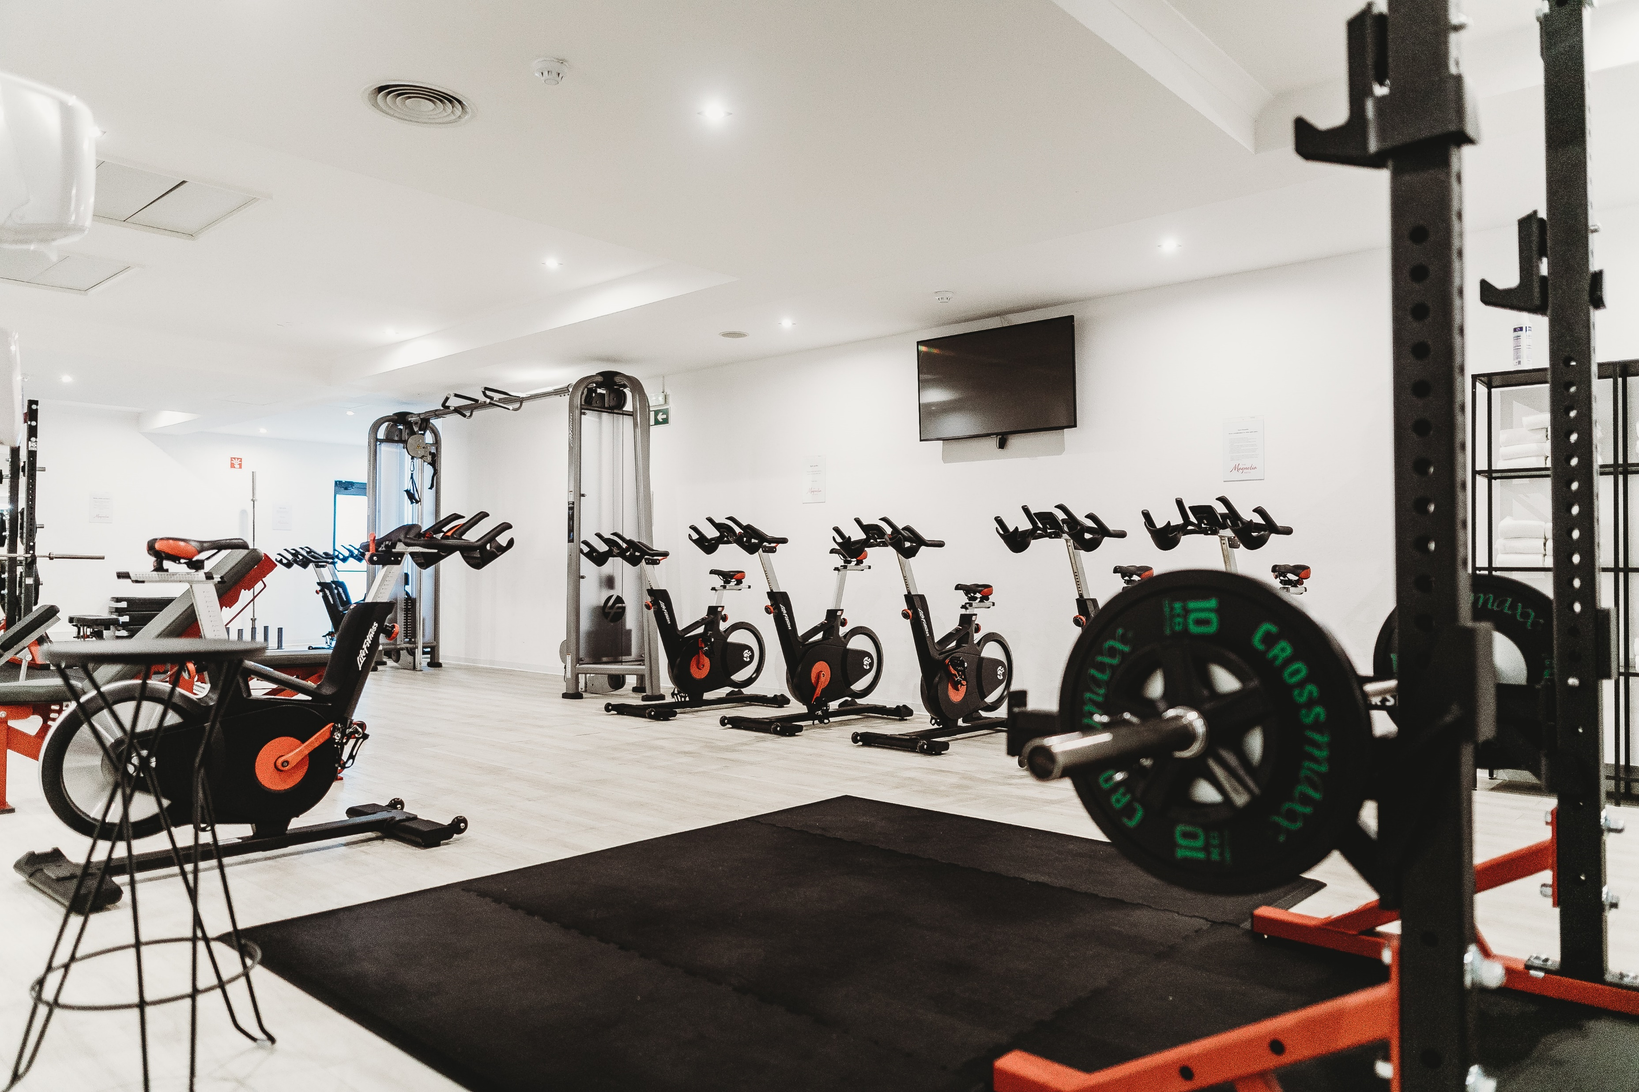
Activities performed in this Exercise
Affinity Diagram: Analyze and identify the major themes in your data.
Empathy Map: Find out how your participants think, feel, talk and act regarding physical exercise.
Point of View: Crystallize and synthesize the user needs.
How Might We: Define the design challenge(s) you’re going to work on for the remainder of the project.ch will help people improve their fitness.

Slide 2
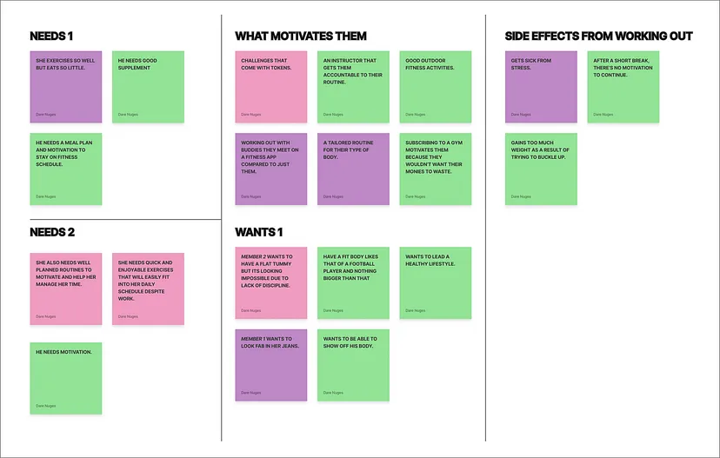
After gathering information and trying to understand potential users, I used this technique to gather and analyze my findings to find trends and connections.
The ones that workout at home and the others at the gym. (User interview and Probes)

Slide 3
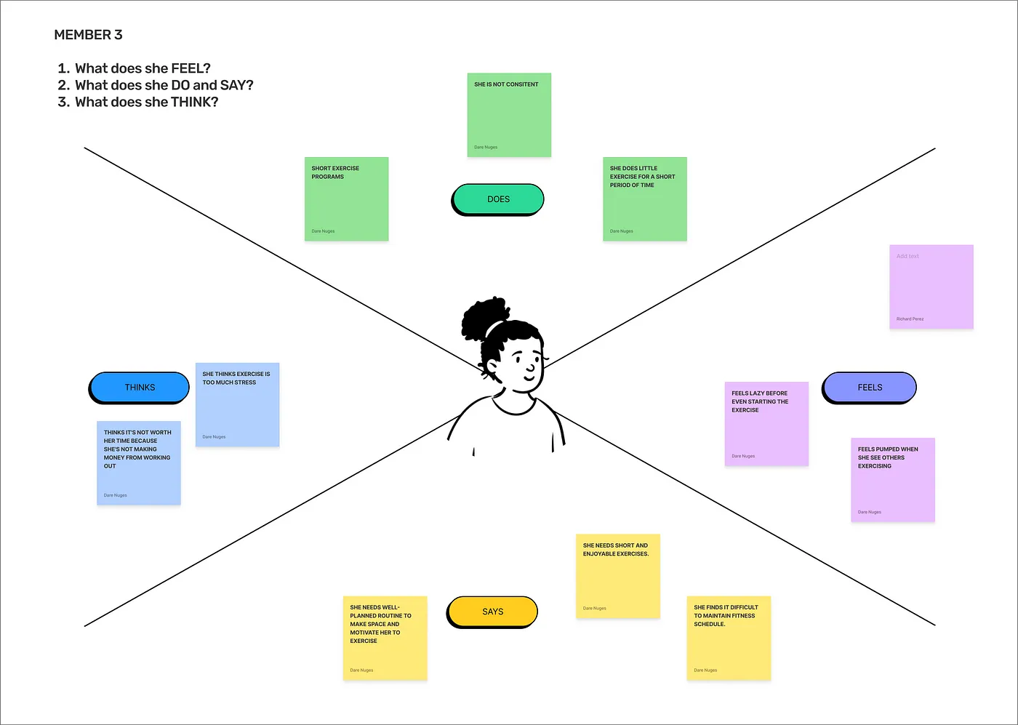
EMPATHY MAP

Slide 4
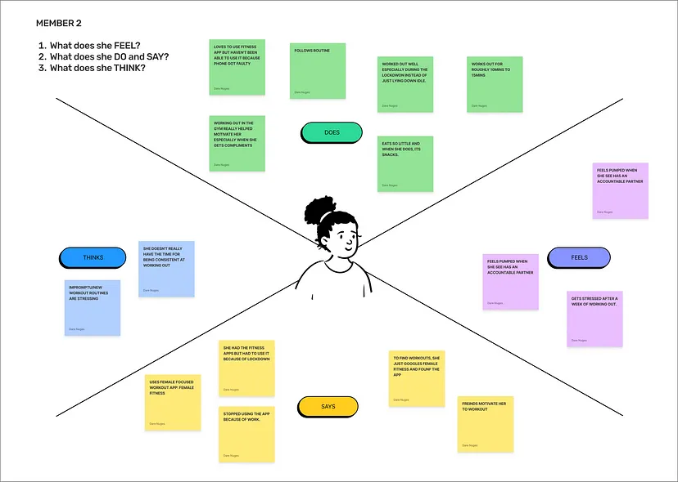

Slide 5
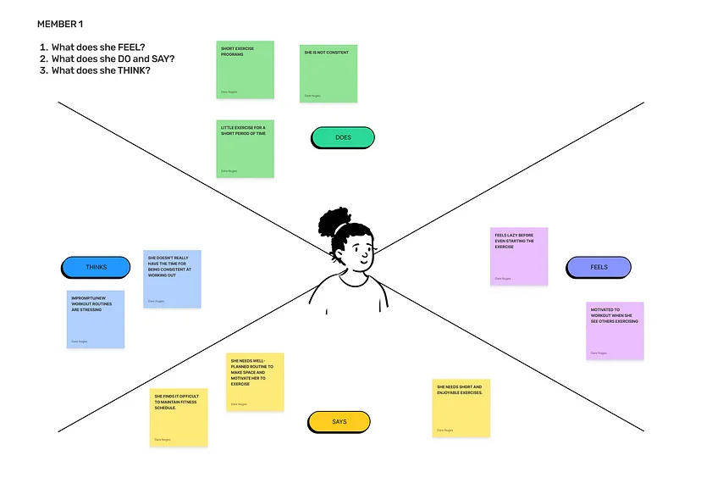

Slide 6
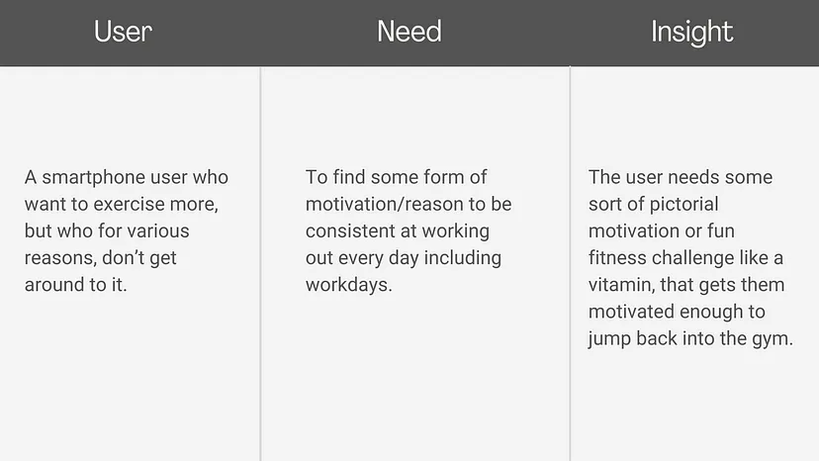
POV & HOW MIGHT WE
I analyzed every members’ needs and their insights and found a common ground/theme

Slide 7
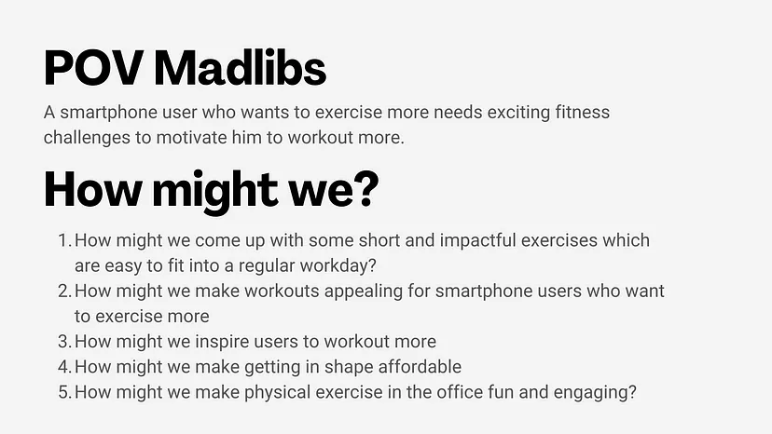

Slide 8
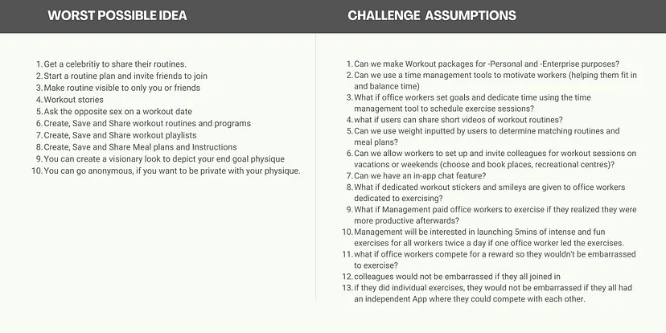
Activities You’ll Perform in this Exercise
If you have a team around you, you can bounce ideas off them as you ideate. Luckily, you can also do it on your own if you use the right methods. In this exercise, we will focus on ideation methods you can use both on your own and in a team:
Worst Possible Idea
Challenge Assumptions

Slide 9
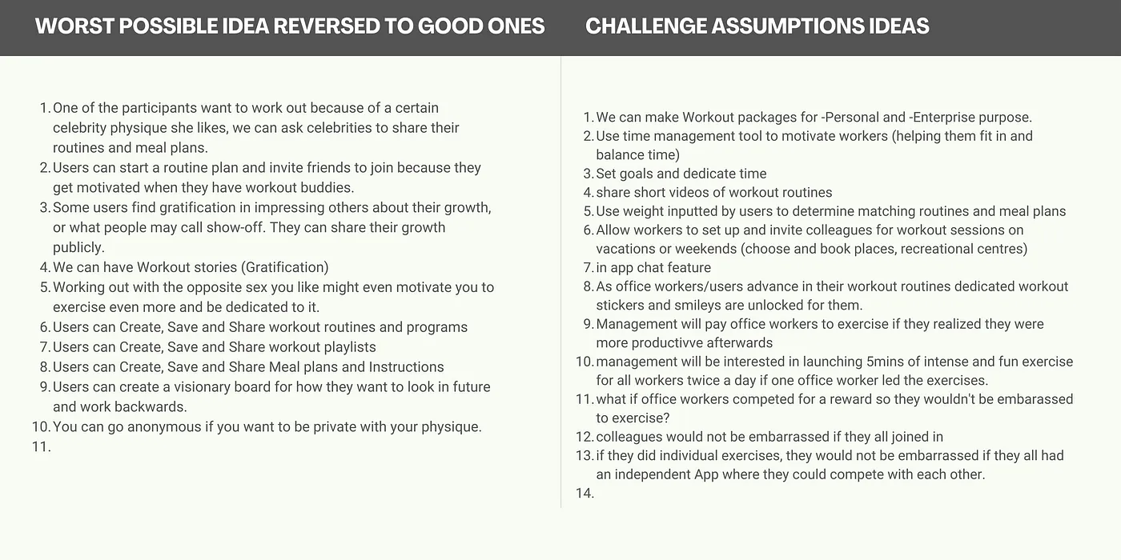
Worst possible idea for ideation process

